Slide 1
Journaling about progress and errors
Dawn Nordquist
University of New Mexico

Slide 2
Background
Mixture of LING majors and majors from Foreign Languages, Speech & Hearing Sciences
Remotely-Scheduled
Active learning interspersed with short lectures
ECURE Fellow & Student Experience Project Fellow
Fall 2020 Courses:
Introduction to Linguistic Analysis
Grammatical Analysis

Slide 3
Summer 2020 workshops
Expanding Course-Based Undergraduate Research Experiences (ECURE)
Student experience Project (SEP)
High Impact Practices
Greater gains for structurally disadvantaged groups (Kuh 2008)
Writing across the curriculum
Cultivate a Growth Mindset (Canning, E., Muenks, K., Green, D., & Murphy, M. 2019)
Signal Social Belonging (Walton, Logel, Peach, & Zanna, 2014)

Slide 4
Journaling
Normalize mistakes as part of linguistic analysis
Formative Assessment for learning (Vonderwell & Boboc 2013)
Eschew Anglo normative writing expectations (Inoue 2019)
Transparent list of skills to master (Zuraw, Aly, Lin, & Royer 2019)

Slide 5
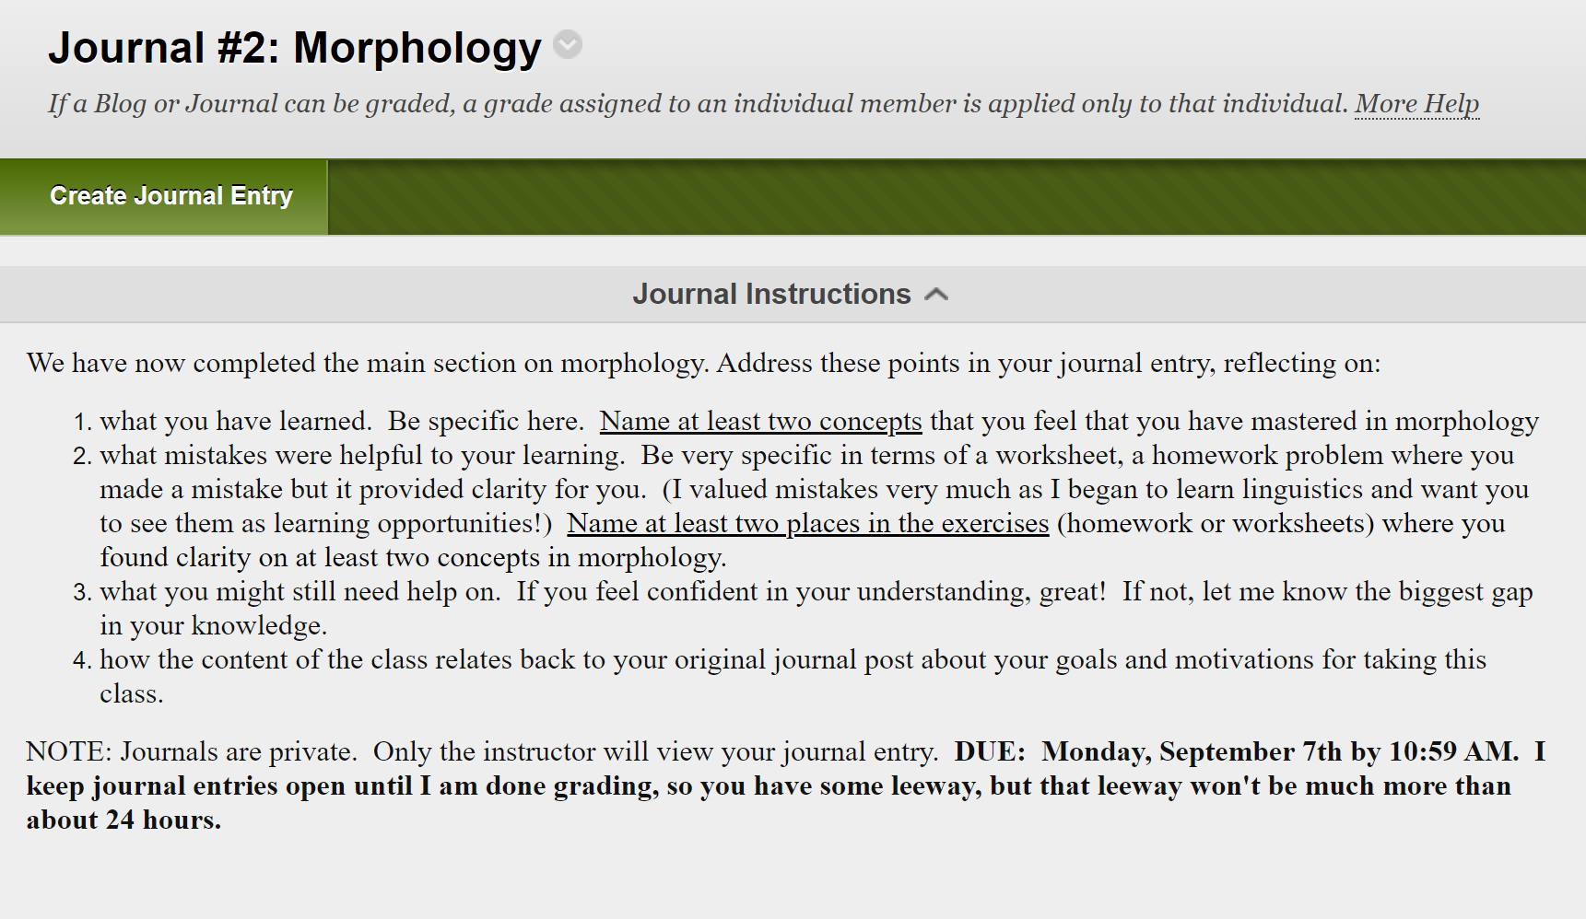

Slide 6
Teacher observations
Revelations
To address
Students will write that they have mastered a skill and in their discussion reveal gaps in knowledge (see Anderson [2016: e287] for similar finding)
Difficulty on reflecting on mistakes
“I need to study harder” - “I didn’t read instructions” - “I made silly mistakes”
Need to provide samples
Individualized responses (Poll, Widen and Weller 2014) time-consuming for instructor
Students don’t necessarily read comments

Slide 7
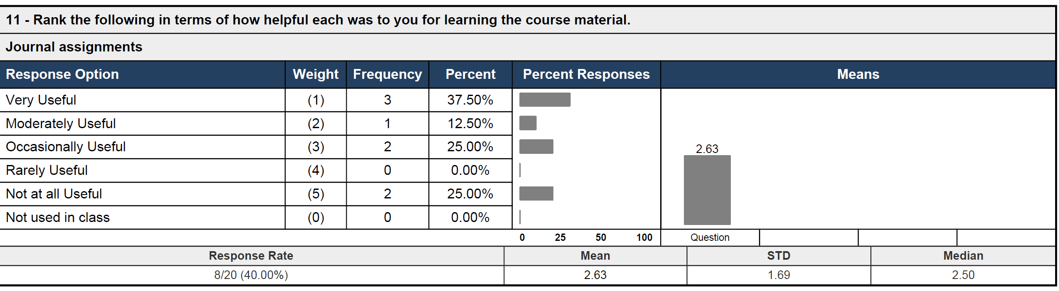
Student Perceptions:

Slide 8
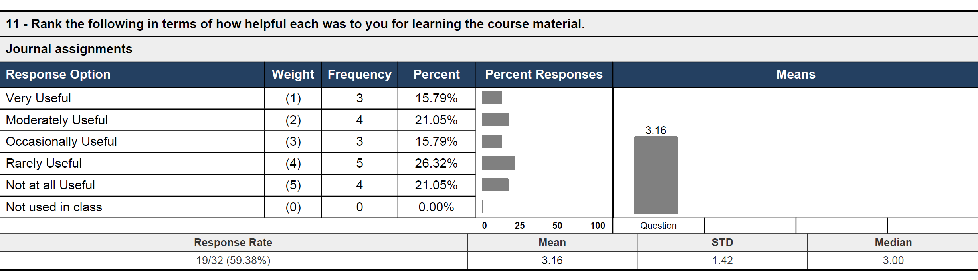
Student perceptions

Slide 9
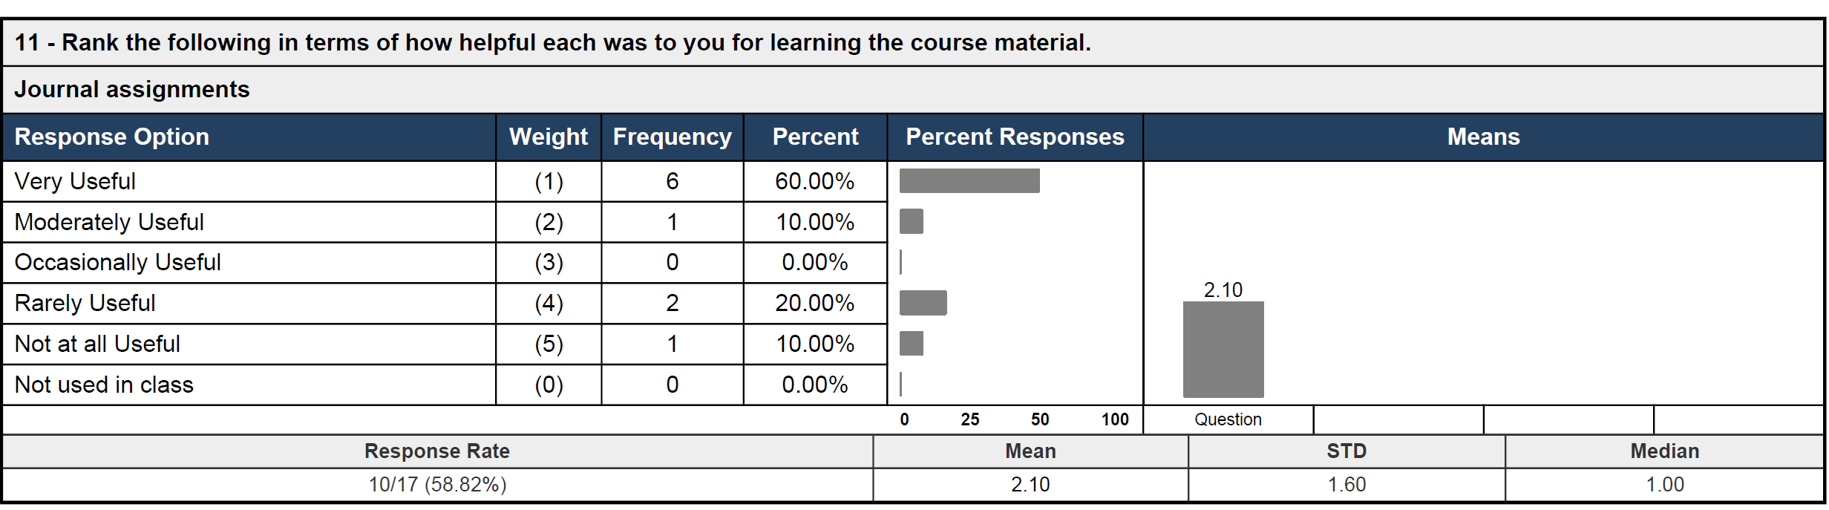
Student perceptions

Slide 10
Student Perceptions
I felt like I had to scramble for things to say half of the time, especially when relating every journal to what I said in the first one. I don't like to bs my way through posts but I always sort of had to on that last point. It did, however, help me target the areas that I needed to practice more on, especially for exams. I even started keeping a record of "aha!" and confusion moments so I would know what to write. At first I thought that this list of things I was collecting was a hassle and a cop-out, but then I realized that for the first time in my life I was actually tracking my learning and doing something about it and in turn, yielding better results in class.

Slide 11
Student perceptions
Positive
negative
Good for reflection
Track progress
Communication with instructor/review for quizzes
Time consuming
Don’t see the relevance
recommendations
More time
Fewer skills

Slide 12
Spring 2021 iteration
Highlight relevance in syllabus
Provide time at end of class for reflection
Fewer skills to report on (Students can select a subset)
Fewer journal entries
Collect data on questions related to social belonging and growth mindset (through SEP)

Slide 13
References
Anderson, C. 2016. Learning to think like linguists: A think-aloud study of novice phonology students. Language 92(4).e274-e291
Canning, E., Muenks, K., Green, D., & Murphy, M. 2019. STEM faculty who believe ability is fixed have larger racial achievement gaps and inspire less student motivation in their classes. Science Advances 5. eaau4734. 10.1126/sciadv.aau4734.
Inoue, A. B. (2019). Classroom writing assessment as an antiracist practice: Confronting white supremacy in the judgements of language. Pedagogy 19(3), 373-404.
Kuh, George D. (2008). “High-impact educational practices: What they are, who has access to them, and why they matter.” AAC&U, Washington, D.C.
Poll, K., Widen, J., & Weller, S. 2014. Six instructional best practices for online engagement and retention. Journal of Online Doctoral Education, 1(1).
Vonderwell, S. K., & Boboc, M. (2013). Promoting formative assessment in online teaching and learning. TechTrends 57(4), 22-27.
Zuraw, K., Aly, A.M., Lin, I., & Royer, A.J. 2019. Gotta catch ’em all: Skills grading in undergraduate linguistics. Language 95(4).e406-e427.
Walton, G. Logel, C., Peach, J. & Zanna, M. 2014. Two Brief Interventions to Mitigate a “Chilly Climate” Transform Women’s Experience, Relationships, and Achievement in Engineering. Journal of Educational Psychology 107(2).468-485.

