Slide 1

Teaching Grammaticality with Online Tools
Beth Rapp Young, Associate Professor – byoung@ucf.edu
University of Central Florida, Orlando
Presentation Opportunities for Scholarly Teaching, Education, & Resources (POSTER)
95th Annual Meeting of the Linguistic Society of America
Saturday, January 9, 2021, 12:00 – 12:30 p.m. PST

Slide 2
Background
UCF is Florida’s largest public university by enrollment (71,948 students in Fall 2020). We have a linguistics minor, but no major.
I developed this assignment for Modern English Grammar, a class that I’ve taught fully online since 2000.
English majors are required to take either this class or History of the English Language. Most students who choose the grammar option plan to become technical writers or English teachers.
Most students don’t have a deep knowledge of formal grammar when they enroll. They have been taught to draw on their language intuition—which makes sense! Great writers don’t need a formal knowledge of grammar any more than great athletes need a formal knowledge of physiology.
However, sheltering students from explicit grammar knowledge--together with ingrained cultural attitudes--creates an environment where linguistic prejudice can flourish. When we encourage students to believe that their preferred language is also the correct language, they can become unduly judgmental towards other language varieties. Not good for future teachers.
One of the goals of my class is to help students see that “grammar” involves more than just error correction. I try to inspire an attitude of CURIOSITY about language and HUMILITY towards all the things we don’t know. Language that might seem unfamiliar or awkward isn’t necessarily wrong.

Slide 3
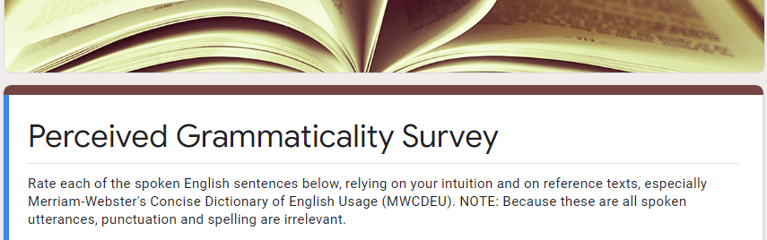
The assignment has two parts, each part with its own deadline, e.g. part 1 due Monday and part 2 due Friday, usually during week 2 of the semester.
For part 1, students review a brief reading about the concept of “grammaticality,” then take an online survey. The survey is hosted in Google Forms, a free online tool that is easy to set up and embed into Canvas, the online course management system used by my university.
You can view an edition of this survey at https://forms.gle/1ZcdJQKwKgjLMqtU6

Slide 4
The survey presents about 15 example spoken utterances and asks students to rate each one as
- I say
            - Other group says
            - Ungrammatical
Utterances include:
  Classic peeves – Hopefully, this survey will be easy.
  Regional idioms – We might could do that.
  Hypercorrection – They told the news to Michelle and myself.
  Unobjectionable – We have some gifts for you.
  Ungrammatical – I’m a week older than Bob is old.
These are invented utterances, but I confirm their grammaticality, usually at english-corpora.org. Plausible yet ungrammatical examples are the most difficult to come up with!

Slide 5
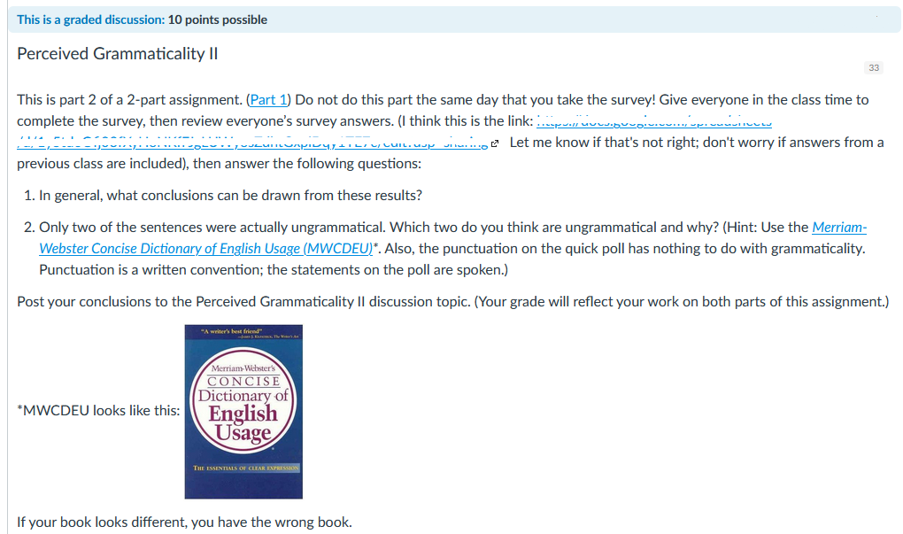
For part 2, on the class discussion board, students:
Review the aggregated class responses and a usage guide
Draw general conclusions from the information
Try to identify the two ungrammatical examples
Google Forms does an adequate, if suboptimal, job of sharing responses. Students should view the graphical pie chart display, not the spreadsheet. See sample results (student identifiers removed), in the accompanying links. Sometimes I post a similar pdf to the class discussion because students have trouble getting to the pie charts online.

Slide 6
Sample student responses: Common theme = surprise
One more time I change my answers! "The students gave the professor it" is grammatically correct because if I change it to a known object--"The students gave the professor the paper"--it didn't sound as strange to me.
I came across some sentences that I hear quite frequently such as "We might could do that." or "They haven't got a strategy." that people do actually say. I guess I'm just surprised that those numbers weren't higher for the "I say" category.
I was taught in high school that it was incorrect to start a sentence with the word "Hopefully" as in the sentence, "Hopefully, this survey will be easy," but for the life of me I cannot remember the reason given.
“I sleep late anymore.” Whether it be ungrammatical or not, I have heard “anymore” used in this fashion by some northerners. . . . It doesn't mean "I never sleep late anymore" but rather "I sleep late all the time." I had a friend from PA and he would say “anymore” in this way and it took awhile for me to understand what he meant because I have never heard it used as such before.
The only sentence that received 100% “I say” was “Hopefully, this survey will be easy”. I’m glad to see we can all agree on something, especially a sentence that is as grammatically correct as this one.
I was tempted to say that "I'm a week older than Bob is old" is ungrammatical because everyone else says it is, but I've never learned that redundancy is a GRAMMATICAL error. It weakens the sentence, but I don't find it to be ungrammatical.
“These dishes need washed.” This one made me cringe a little bit. It makes sense that the “to be” has been dropped out of the sentence to make the sentence shorter in common spoken usage, although I don’t know how to specifically say how it is ungrammatical in written terms. What function does the word “washed” play here?
I asked my husband to give me his opinion because I wanted to see if we would have the same or at least similar answers since we spend so much time together. I was surprised to find that there were several that we didn’t agree on.
The Miriam-Webster Concise Dictionary says that "These constructions (might could, might should, etc,) are not found in print except as part of reported or fictional speech." That they aren't found in print leads me to believe that they are in some way considered ungrammatical. Is vernacular on the same level as written English? Is it only grammatical if it's written?
I was amazed by the inconsistency of the results from the survey quiz. Not one question was answered unanimously, which means that the way we all speak is very different from each other.

Slide 7
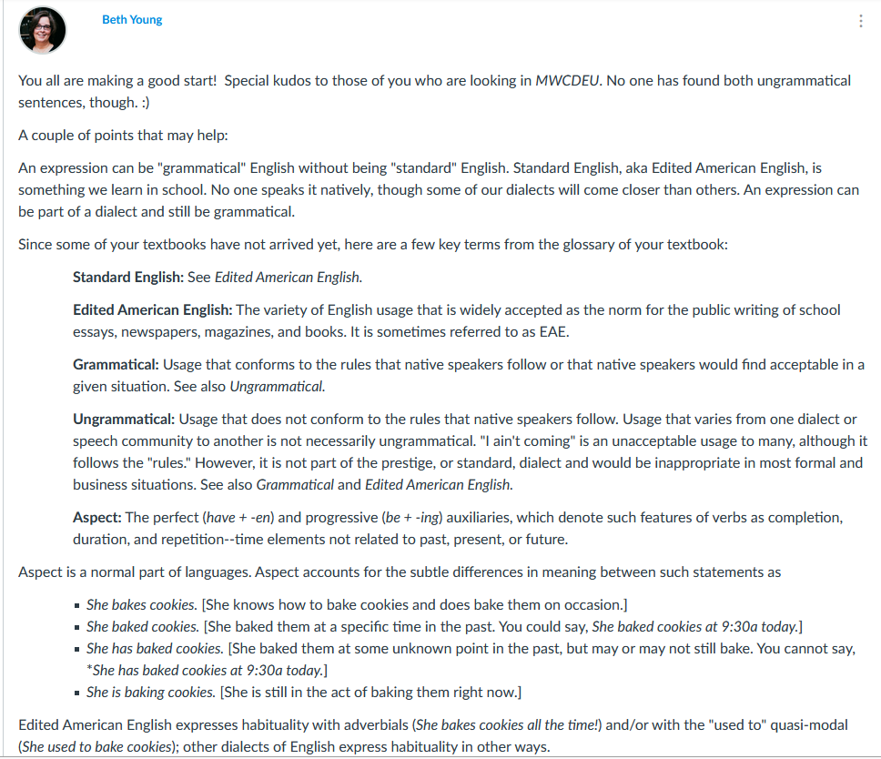
I chime in occasionally if they need a nudge.
(Here, some students had located information about habitual be, but they didn’t seem to understand what “aspect” meant.)

Slide 8
Student conclusions are often insightful.
Prescriptive grammar makes us squirm--at least when we are put on the spot as to whether a sentence is grammatical or not. Status is conferred on those who know what “good” grammar is, since good grammar is a reflection of how we were raised, where we grew up, and how much education we have. Our anxiety and sudden uncertainly was shown in all of the times we chose what others would say or in our perceived ungrammaticality of perfectly good sentences.
What was interesting about this exercise was not what we as a class agreed was grammatical (there was actually only one sentence that everyone agreed on: Watching them eat insects made me feel nauseous.), but that we questioned what we innately knew.
Upon review of the results, it can be stated that, though the class can come to grammatical agreeance on some phrases, there is a difference of opinion in terms of what is "proper grammar" and what is not. There are various lexical and syntactic preferences-- none of which are necessarily "improper". For example, "He be eating cookies" seems ungrammatical (traditionally speaking), but it is very prevalent in Black English (MWCDEU: 123). We cannot assume a phrase is ungrammatical based solely on our own grammatical schooling and upbringing.
From the results it seems that most respondents confuse regional or dialect English with incorrect grammar. While some things may not have been the way we would say them, they weren’t necessarily incorrect.
I think we sometimes get wrapped up in our own little “grammar world” and forget the way people from different walks of life speak. It’s easy to get on board with the notion that the way you, your family and the people in your environment talk is the correct way to do so, but the English language can be so subjective. I do find myself in a battle between believing that following the guidelines of Standard English is the only way to be grammatical and that dialectical differences can still be grammatical.

Slide 9

Grading is based solely on participation.
After the part 2 deadline, I post one grade for the whole thing: 10 points maximum (out of 1000 points in the class).
Students earn 5 of the 10 points if they complete the survey by the part 1 deadline. They earn the remaining 5 points if they write at least one discussion post by the part 2 deadline.
I don’t care whether they figured out which examples were really ungrammatical, just that they tried.
I do congratulate those students who did identify the ungrammatical sentences—and I give the class more information about the controversial examples. Also “fun facts” when I can find them.
Fun fact: There’s a band named “Might Could” . . . that has an album titled Wood Knot.

Slide 10
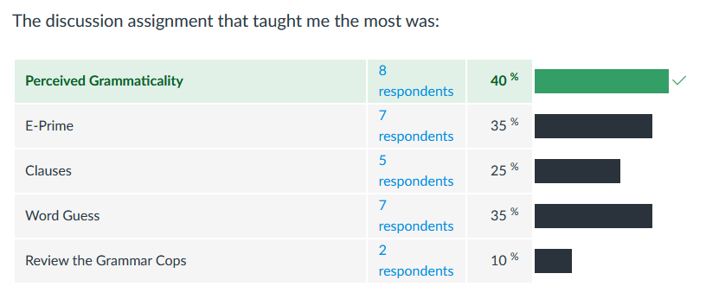
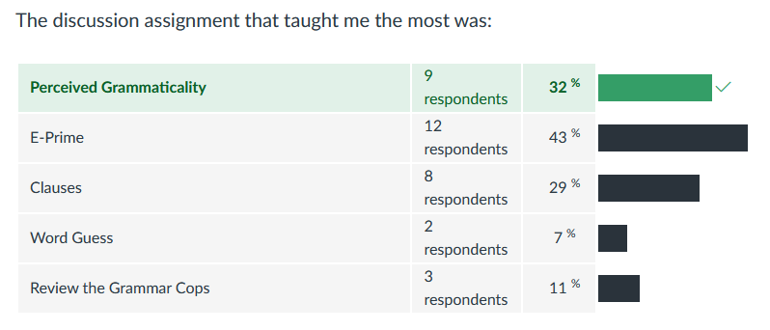
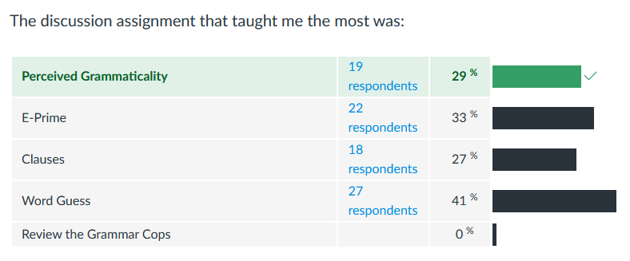
In anonymous end-of-semester surveys, students often choose this assignment as “the discussion assignment that taught me the most” (though it isn’t always #1).
Results from my last three semesters.

Slide 11
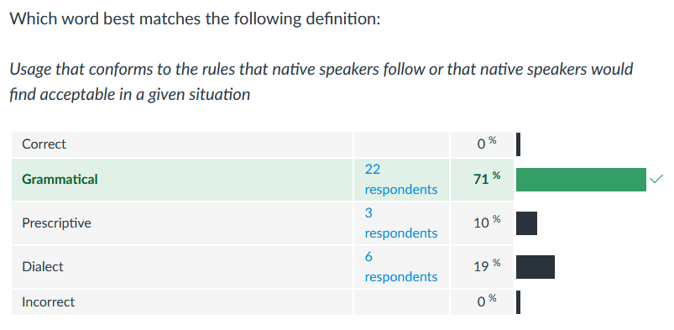
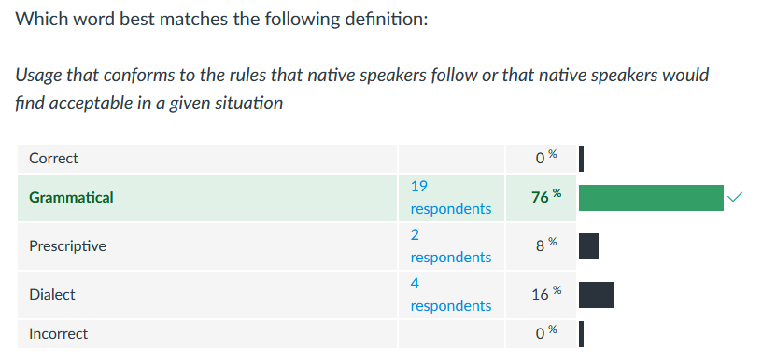
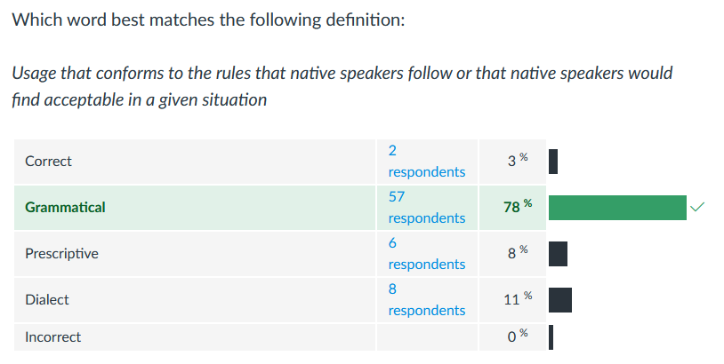
On the final exam, most students are able to define “grammaticality.”
Results from my last three semesters.
As a teacher, I can talk at length about how English is more than just written English, and about how much even native speakers have yet to discover. But when students make these discoveries themselves, the lessons seem more likely to stick.

