Slide 1
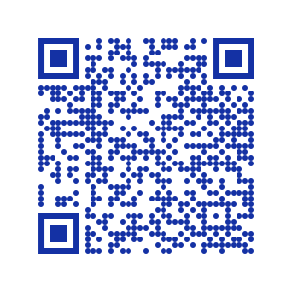
Engaging with linguistic justice
through objectives-based learning & independent research
Julia Nee (jnee@berkeley.edu) & Emily Remirez (eremirez@berkeley.edu)
PhD candidates, UC Berkeley Department of Linguistics | Presentation materials
We are honored to be presenting this work,
which was carried out on the traditional, ancestral, and unceded land of the Ohlone people,
and we acknowledge that the Ohlone people’s relationships with this land continue to this day.

Slide 2
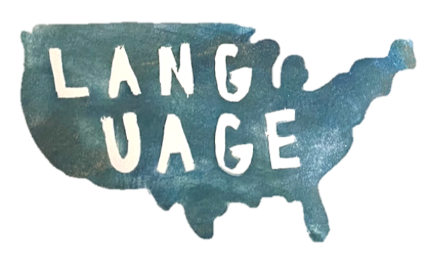
Course overview: Language in the US
Introductory course examining language and social structures (including race, gender, and class) in what is now known as the US (syllabus)
  Fulfills university American Cultures requirement
  No prerequisites; 41 students from a variety of majors
Intensive 6-week summer course (2 synchronous hours/day, Monday-Friday)
  Course lecture & discussion with Julia Mondays through Thursdays
  Research methods & project development with Emily on Fridays
Learning objectives for class meetings are submitted “daily”
  Flexible due dates & formats (recordings, short answers, discussion posts)
  Ability to re-submit multiple times
Independent research project (assignment)
  Synthesized course material with students’ own experience & expertise
  Built up incrementally through milestones (1, 2, 3) with peer & instructor feedback

Slide 3

We wanted students to...
Participate sincerely and constructively
Feel respected, valued, and capable of success
Develop robust investment as learners
View themselves as not only consumers but constructors of knowledge
Interrogate the way value is assigned to different types of knowledge
Reflect on their own positions within systems of oppression
Integrate course content with the realities of Summer 2020
Practice and acquire skills applicable beyond the classroom

Slide 4
Learner investment
(Norton Peirce 1995)
The learner needs an environment that is supportive and accepting of students’ identities
“A student may be a highly motivated learner, but may not be invested...if [classroom] practices are racist, sexist, or homophobic.” (Darvin & Norton 2015)

Slide 5

Learning objectives-based framework*
All assessments are formative, providing data that inform students’ progress
  Lowers stakes of any single assignment
  Encourages progress from any starting point
Grading is transparent and reflects only student mastery
  Robust to circumstances beyond students’ control
  Ameliorates the effect of situational inequities on students’ grades
Mistakes are central to the learning process
  Reduces fear of failure, increasing sincere participation
  Parallels the authentic and iterative process of research
*Based on Grading for Equity (Feldman 2019)

Slide 6
Sample student output: Learning objective
Learning objective: Explain the socially constructed nature of the concept of race in America by examining how individuals may be considered as belonging to different races depending on the social context.
Sample submission
Result: Students connected ideas from inside & outside the classroom to provide personalized, nuanced reflections on difficult concepts
First submission: C
Incorporated sources explored in the course: art from the Tlacolulokos, reading of Garrett et al. (2018), course lecture about research ethics
Feedback
Say more about racial categories have/haven't changed over time/space
Second Submission: A
Added connections to guest lectures from Profs Beth Piatote & Rich Rhodes and independent reading of Tommy Orange's There There

Slide 7
Sample student output: Learning objective
“Attitudes toward race certainly change over time, and we read earlier in this course that certain Indigenous individuals wanted to pass as White in California to escape that genocide that befell their groups, from Garrett et al. ...
This was represented in Tommy Orange’s novel There There … One of his characters felt alienated from Indigenous ways of life due to his urban life in Oakland … it was important for the character to feel like he was valid in his interest in participating and learning more about the culture that did belong to him but was removed. This is similar to Professor Piatote’s apprehension when playing with Nez Perce language, as she does not want to make a mistake and have the language stray too much from the way her ancestors might have used it. On the other hand, it is hers to play with as a cultural and racial inheritance.
...race and belonging can be fluid in different spaces depending on social power dynamics.”

Slide 8
Sample student output: Research project
Becoming “American”: Language loss within the Japanese American community during the early- to mid-20th century
Question: Why did the Japanese Americans whose ancestors immigrated to the United States prior to World War II shift from speaking primarily Japanese to primarily English?
Sources: Interviews with grandparents & mother, Japanese American National Museum collections, peer-reviewed research from class & independent literature search, personal reflection
Themes: Japanese internment, pressure to assimilate, “model minority” myth and pan-Asian groupings
Other Topics:
How has language around special education changed through multiple generators of educators?
How have attitudes toward being multilingual changed, and how does this interact with race and class?
How have two generations of Armenian immigrants and Armenian Americans maintained ties to their language and culture?

Slide 9
Results & feedback
Classroom environment allowed students to feel:
  Respected (21/21 respondents strongly agreed)
  Included (17/21 respondents strongly agreed, 2 somewhat agreed, 1 somewhat disagreed, 1 NA)
Flexible deadlines promoted learning:
  “I liked how she was flexible with deadlines...due to technological issues, pandemic-related mental health crises, taking care of younger sibling, etc., I missed almost every deadline, but I was still able to learn and get feedback on my work.”
  “It really encouraged me to learn and catch up on assignments whenever I fell behind.”
Students had authentic and independent experiences
  23/26 felt more prepared to take on research projects in the future
  23/26 felt they practiced skills they can use in the future
  “[Emily] was very enthusiastic about our project ideas and the final project was open enough that we could do our own research on whatever we found interesting which made it much more independent than following a prompt”

Slide 10
Results & feedback
Students engaged with feedback and resubmissions:
  21/21 agreed that they feel comfortable incorporating feedback and resubmitting
  “Normally when I turn in an assignment, I don’t necessarily expect a thoughtful reply and comment that shows that the instructor took their time to read and understand what the student is thinking about. I really got this sense of care from this course staff. I tended to write a lote in my assignments and despite this, each and every single one had a thoughtful comment...this really encouraged me to finish the assignments and learn the material.”
  “I was always well aware of what was expected of me and how to reach out for help.”
Room for improvement:
  Integration between research projects in discussion section and lecture
  Normalization of resubmitting & refining rather than duplicating work
  Effective modes of interaction in virtual environment:
    Stable discussion groups with the same folks
    Groups of 3-5 rather than pairs

Slide 11
Thank you!
Questions? Email us at
jnee@berkeley.edu
eremirez@berkeley.edu
And thanks to
Generous guest speakers*
Victoria Robinson & the UC Berkeley American Cultures Program for providing feedback & funding
Prof Andrew Garrett for supporting course staff through the challenging summer term
Prof Richard Rhodes & Raksit T. Lau-Preechathammarach for sharing resources and wisdom from past iterations of the course
Our wonderful students!
*guests included Isaac Bleaman, Roslyn Burns, Kristin Foringer, Leanne Hinton, Aurora Martinez Kane, Sharese King, Edwin Ko, Vincent Medina, Beth Piatote, Louis Trevino, & Eric Wilbanks.

